Slide 1
Thyroid Disease Detection

Slide 2
Objective
The main goal of project is to predict the risk of hyperthyroid and hypothyroid based on various factors of individuals.Thyroid disease is a common cause of medical diagnosis and prediction with an on set that is difficult to fore case in medical research.It will play a decisive role in order to early detection,accurate identification of the disease and helps the doctors to make proper dicisions and better treatment

Slide 3
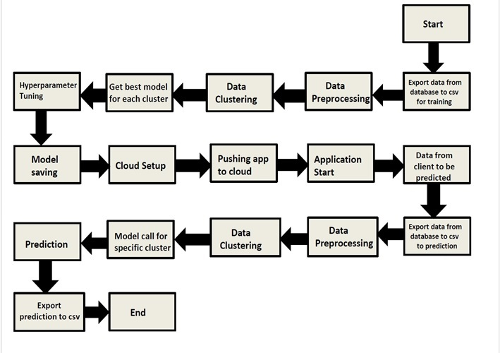
Architecture

Slide 4
Dataset Variables
1) Age of the person
2) Sex Male or Female
3) On_thyroxice True or False
4) Sick True of False
5) Pregnant True or False
6)Tyroid Surgery True or False
7)l131_treatment True or False
8)Query_hypothyroid True or False
9)Query_hyperthyroid True or False
10)Lithium True or False
11)Goitre True or False
12)Tumor True or False

Slide 5
Data Analysis Process
Data collection
Model Creation and Evaluation
Data Preprocessing
Feature Selection
Exploratory Data Analysis

Slide 6
Model Traning And Validation Workflow
* Data Collection
Tyroid Disease Data set from UCI Machine Learning Repository
* Data Pre-Processing
Missing Values Handling by simple imputation(Used KNN imputer)
Outlier detection and removal by boxplot and percentile methods
Categorical feature handling by ordinal encoding and label encoding
Feature scaling done by Standard Scaler method
Imblanced dataset handled by SMOTE-Over sampling
Drop unnecessary columns

Slide 7
Model Traning And Validation WorkFlow
Model Creation and Evaluation
Various classification algorithms like random forest,XG Boost,KNN,etc tested.
Random Forest, Xgboost and KNN all were given better results.XG Boost was chosen for the final model traning and testing
Hyper parameter tuning was performed
Model performance evaluated based on accuracy,confusion matrix,classification reprot

Slide 8
Thanks

